Slide 1
Linear Models

Slide 2
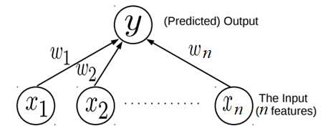

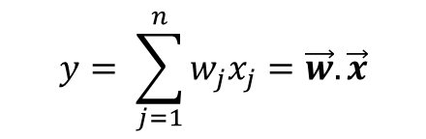

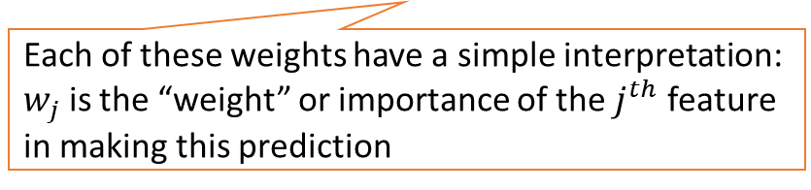
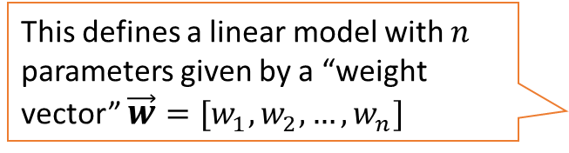
Linear Models
Consider learning to map an input$\vec{x}∈ℝ^{1×n}$ to the corresponding (say real-valued) output $y$
Assume the output to be a linear weighted combination of the $n$ input features
This simple model can be used for Linear Regression
This simple model can also be used as a “building block” for more complex models
This defines a linear model with $n$ parameters given by a “weight vector” $\vec{w}=[w_{1},w_{2},…,w_{n}]$
$$y= \sum_{j=1}^{n}{w_{j}x_{j}=\vec{w}.\vec{x}}$$
Each of these weights have a simple interpretation: $w_{j}$ is the “weight” or importance of the $j^{th}$ feature in making this prediction
The “optimal” weights are unknown and have to be learned by solving an optimization problem, using some training data

Slide 3
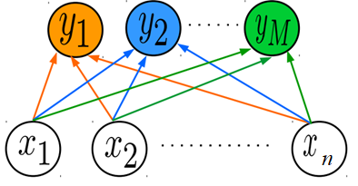
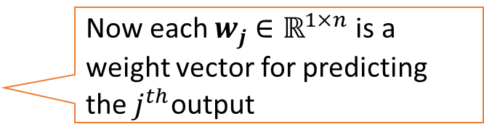








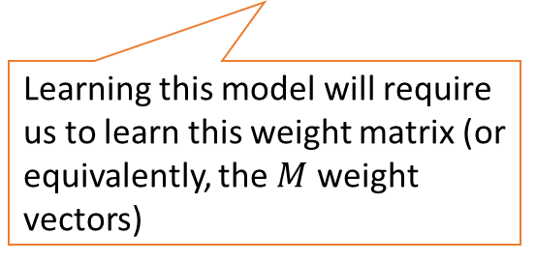

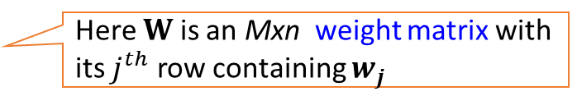

Simple Linear Models as Building Blocks
In some regression problems, each output itself is a real-valued vector $\vec{y} ∈ℝ^{1×M}$
Example: Given a full body image of a person, predict height, weight, hand size, and leg size ($M=4)$
OR Stage-1, 2, 3, 4 cancer prediction
Such problems are commonly known as multi-output regression
We can assume a separate linear model for each of the $M$ outputs $y_{c }(c=1,2,…,M)$
Now each $w_{j}$ $∈ℝ^{1×n}$ is a weight vector for predicting the $j^{th}$output
$$y_{j }=\vec{w_{j}} . \vec{x}$$
$$\vec{y}=\vec{x}WT$$
Here $W$ is an Mxn weight matrix with its $j^{th}$ row containing $w_{j}$
Learning this model will require us to learn this weight matrix (or equivalently, the $M$ weight vectors)
$$=$$
$$w_{1}^{T}$$
$$w_{2}^{T}$$
$$w_{M}^{T}$$
$$y$$
$$x$$
$$WT$$

Slide 4
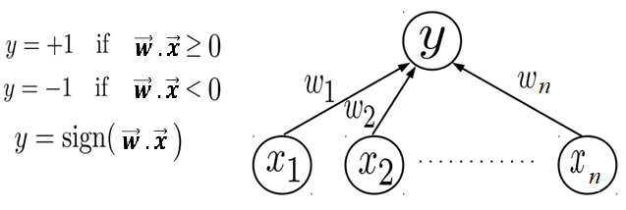
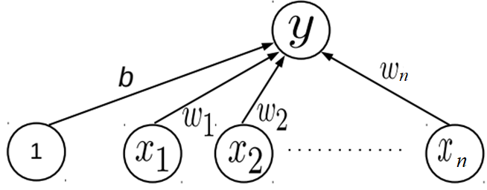

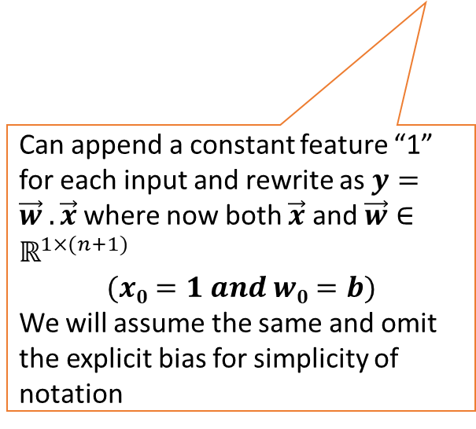

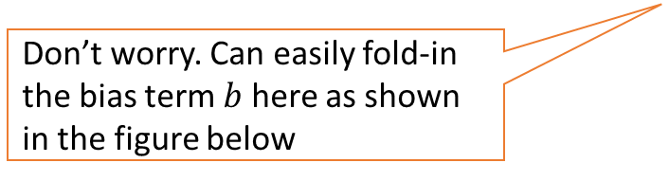
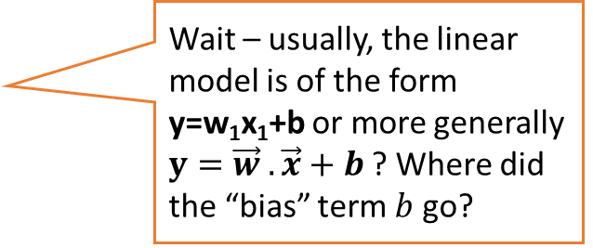

Simple Linear Models as Building Blocks
A linear model $y=\vec{w} .\vec{x}$ can also be used in classification problems
For binary classfn, can treat $\vec{w} .\vec{x}$ as the “score” of input $x$ and threshold to get binary label
Don’t worry. Can easily fold-in the bias term $b$ here as shown in the figure below
Can append a constant feature “1” for each input and rewrite as$y=\vec{w} .\vec{x}$ where now both $\vec{x}$ and $\vec{w}∈$ $ℝ^{1×(n+1)}$
$$(x0=1 and w0=b)$$
We will assume the same and omit the explicit bias for simplicity of notation
Wait – usually, the linear model is of the form y=w₁x₁+b or more generally $y=\vec{w} .\vec{x}+b$? Where did the “bias” term $b$ go?
$$y= \sum_{j=1}^{n}{w_{j}x_{j}+b=\vec{w}.\vec{x}+b}=\sum_{j=0}^{n}{w_{j}x_{j}=\vec{w}.\vec{x}}$$

Slide 5
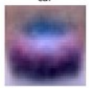
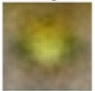
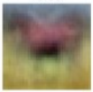
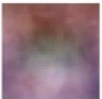
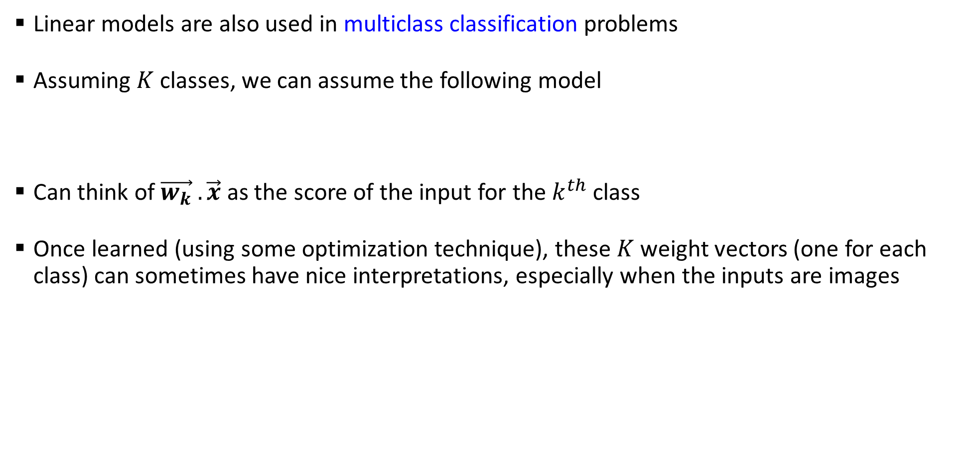





Simple Linear Models as Building Blocks
Linear models are also used in multiclass classification problems
Assuming $K$ classes, we can assume the following model
Can think of $\vec{w_{k}} . \vec{x}$ as the score of the input for the $k^{th}$ class
Once learned (using some optimization technique), these $K$ weight vectors (one for each class) can sometimes have nice interpretations, especially when the inputs are images
$$y= {argmax}_{k∈\{1,2,…,K\}}\vec{w_{k}} . \vec{x}$$
The learned weight vectors of each of the 4 classes visualized as images – they kind of look like a “template” of what the images from that class should look like
$$w_{car}$$
$$w_{frog}$$
$$w_{horse}$$
$$w_{cat}$$
That’s why the dot product of each of these weight vectors with an image from the correct class will be expected to be the largest

Slide 6
Learning Linear Models

